Slide 1


Slide 3
Introducing: TrueCharts
Community Apps Catalog for TrueNAS SCALE

Slide 4

Over 170 Apps

Slide 5
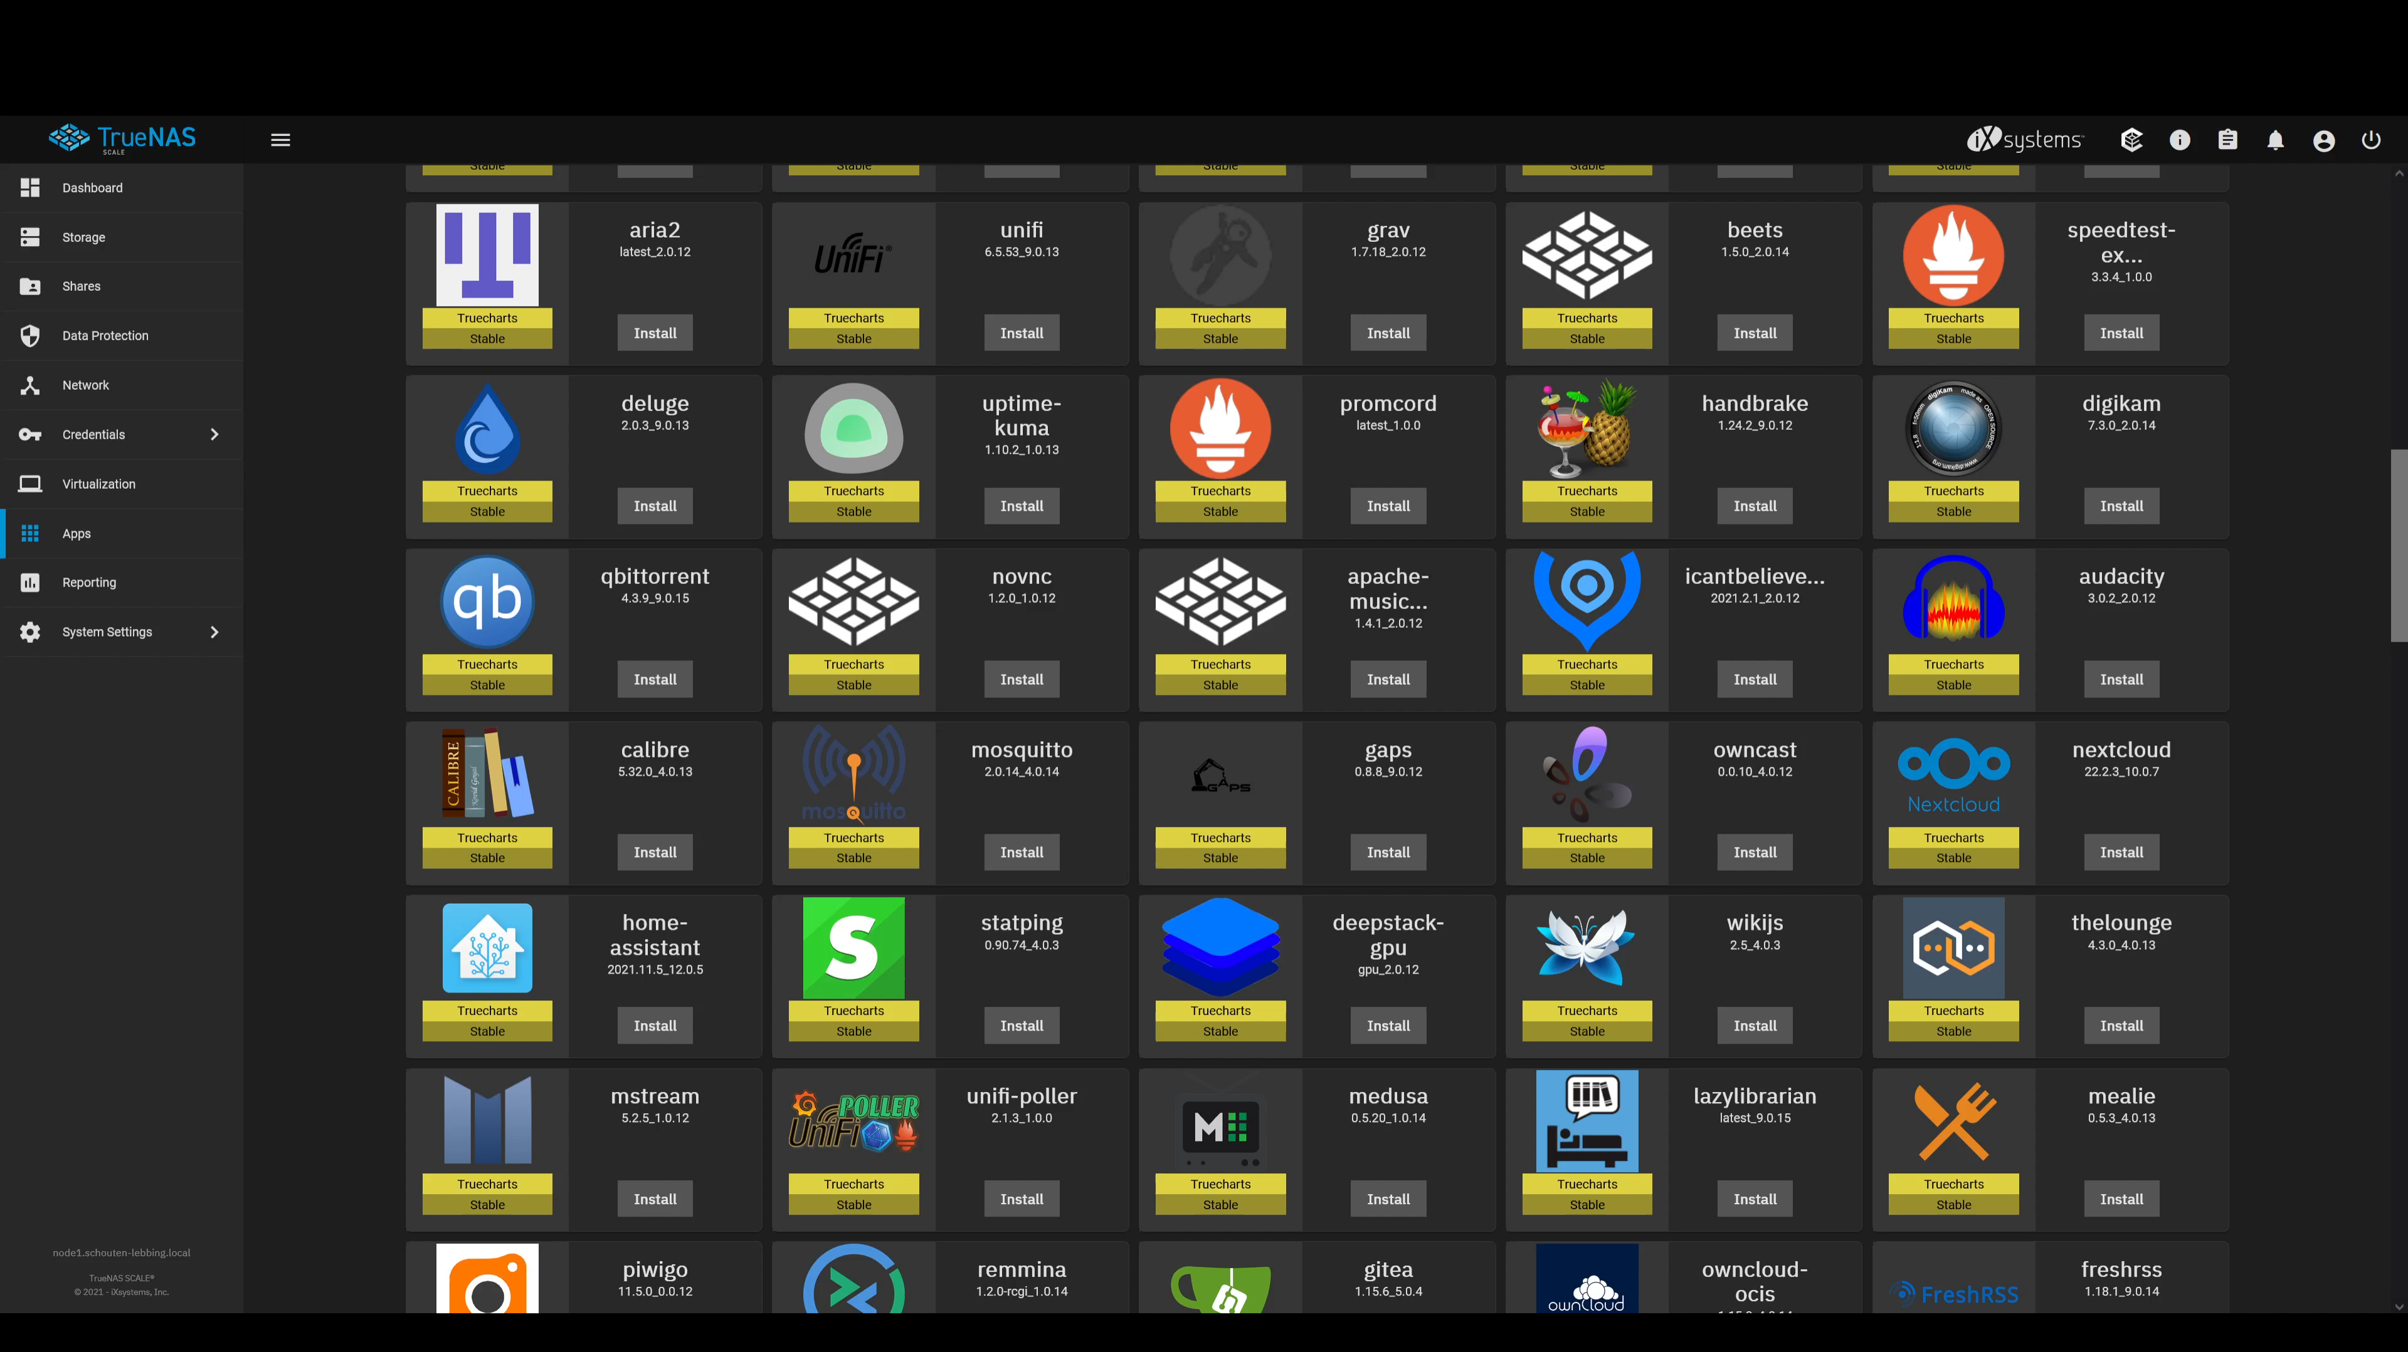

Slide 6
Over 170 Apps

Slide 7
Over 170 Apps

Slide 8
Over 170 Apps

Slide 9
Easily adding the Catalog
Adding the catalog couldn’t be easier

Slide 10
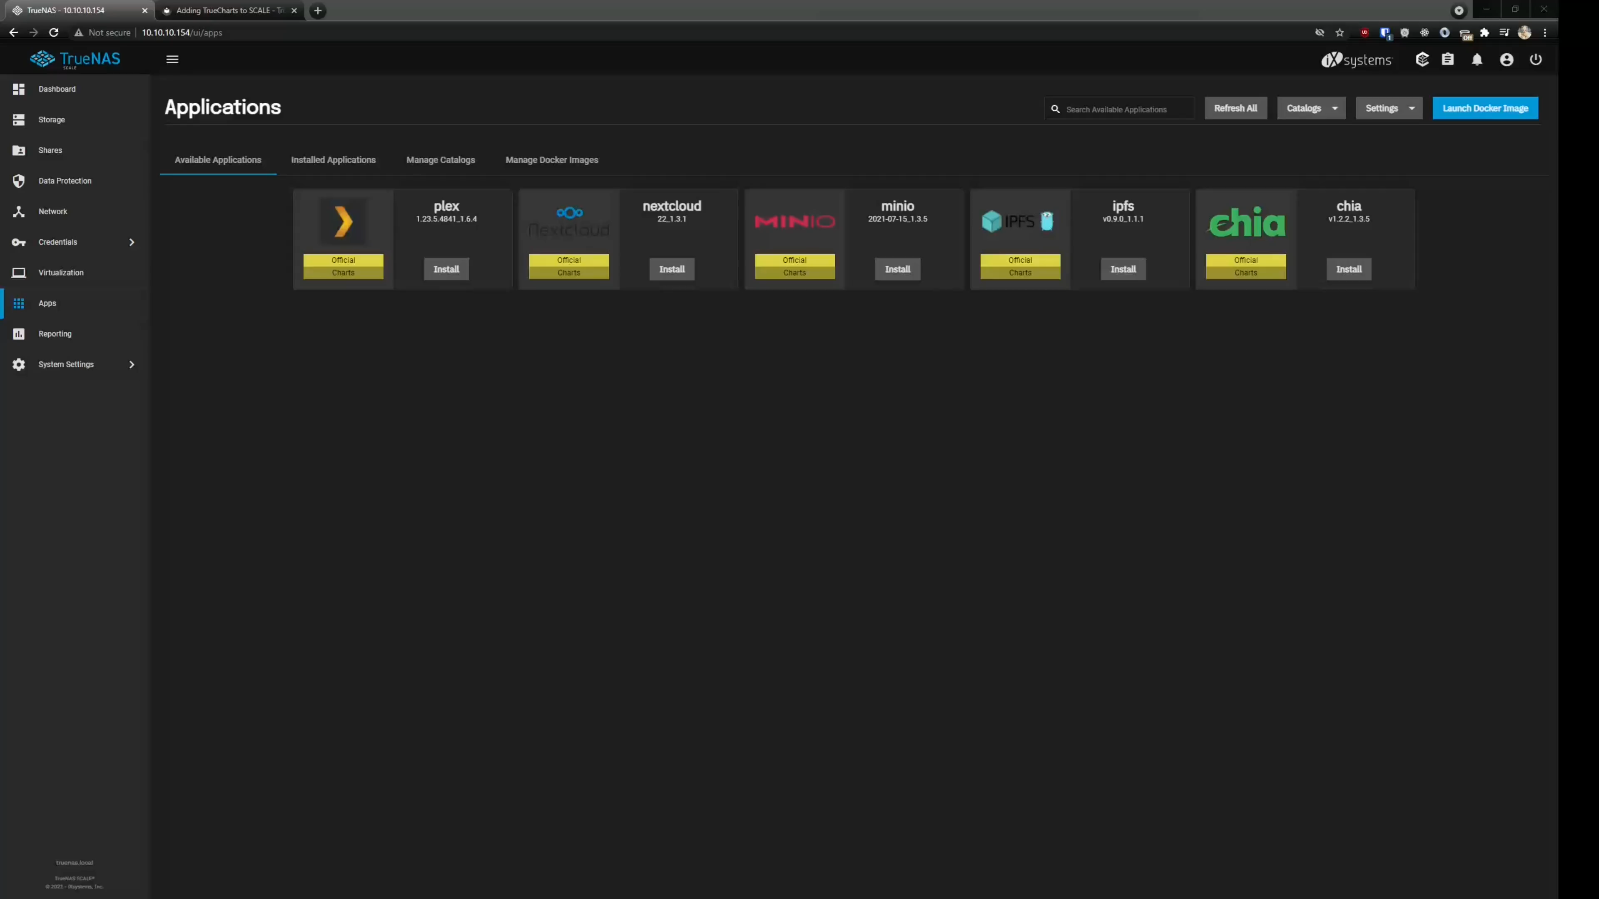

Slide 11
Quick to get going
Installing your first Apps takes only a split second

Slide 12
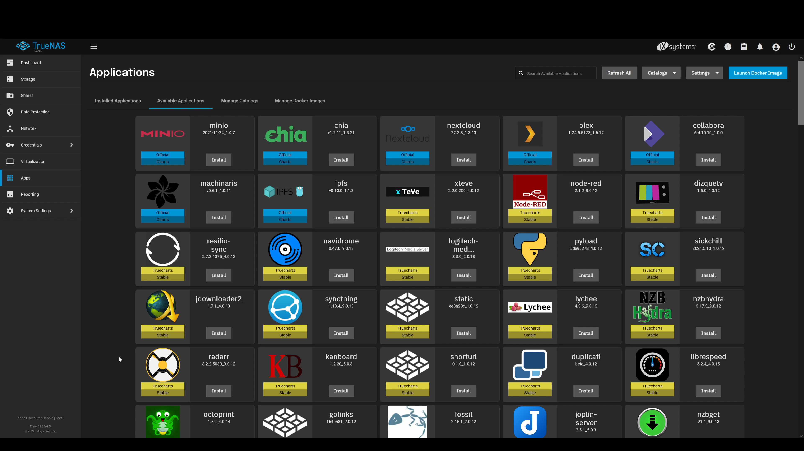

Slide 13
Frequent updates
Let your updates be our burden

Slide 14
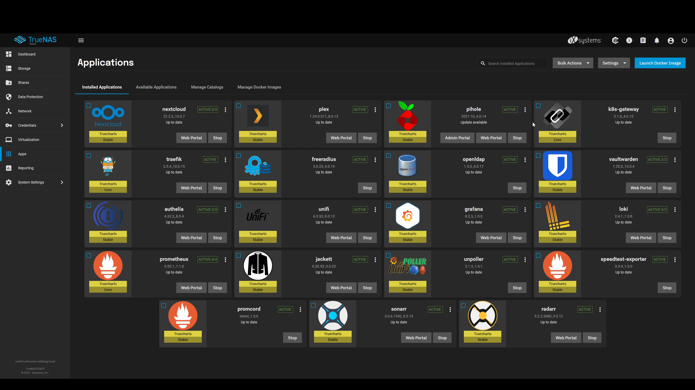

Slide 15
Active Support Community
If all else fails, we are there for you!

Slide 16
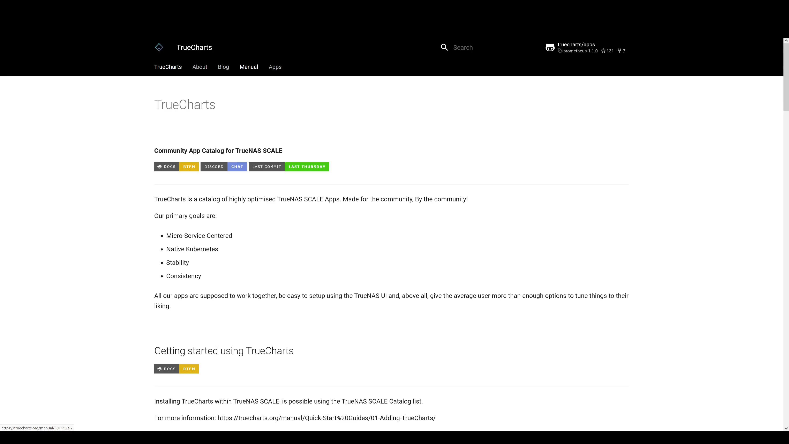

Slide 17
TrueCharts and TrueNAS
Endless Possibilities

